Slide 1
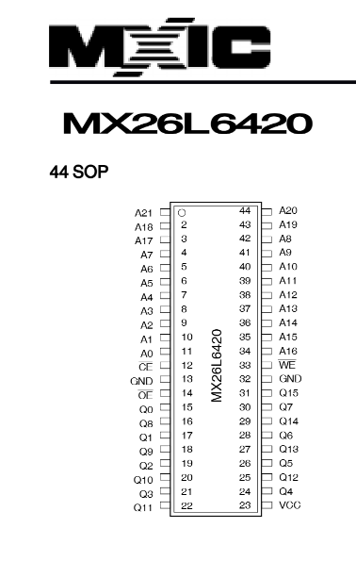
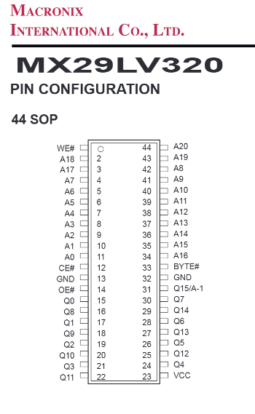
Cut trace and use bodge wire from pin 1 to VCC
On actual bootleg PCB
For drop-in replacement
To LS174 Q0, bankswitching
(not used in Sengoku 2)
High for read mode
GND on PCB
To 3.3V
Low for read mode
High for WORD mode
GND on PCB
GND on PCB
GND on PCB
GND on PCB
To LS139 O_{0a}
To LS139 O_{0a}

Slide 2
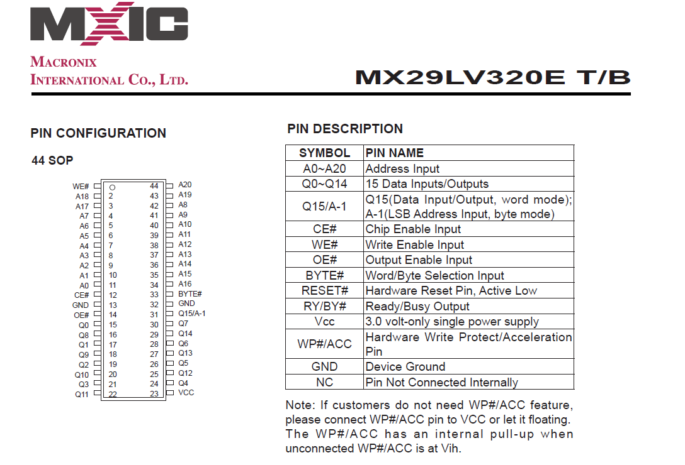

Slide 3
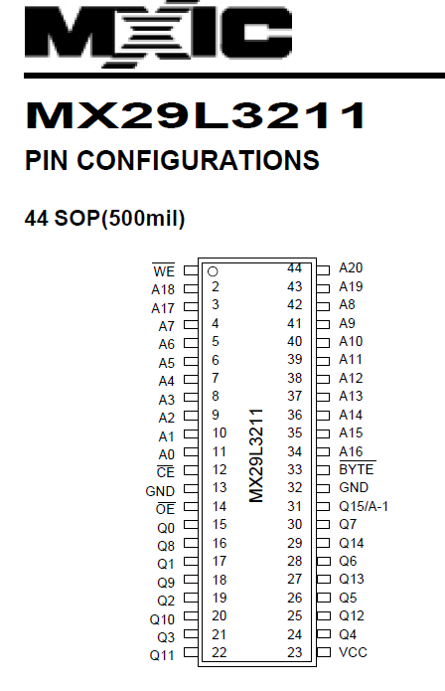
Cut trace and use bodge wire from pin 1 to VCC
On actual bootleg PCB
For drop-in replacement
To LS174 Q0, bankswitching
(not used in Sengoku 2)
High for read mode
GND on PCB
To 3.3V
Low for read mode
High for WORD mode
GND on PCB
GND on PCB
GND on PCB
GND on PCB
To LS139 O_{0a}
To LS139 O_{0a}

Slide 4
